Slide 1
Transport efficiency analysis
Presented by
Karmugilan (212921106038)
Ece(3rd year)

Slide 2
Abstract
Transport efficiency is a critical aspect of modern logistics, impacting both economic and environmental factors. By assessing key performance indicators, we aim to provide insights into optimizing transportation processes.

Slide 3
Procedure
Data Collection:Gather data on transportation activities, including routes, distances, fuel consumption, and cargo volume
Collect information on vehicle types, maintenance records, and driver performance
Define relevant KPIs such as fuel efficiency, delivery time, vehicle utilization, and carbon emissions
Establish benchmarks based on industry standards and organizational

Slide 4
Procedure
Analysis:Utilize data analytics tools to evaluate the collected data and calculate KPI values.Identify areas of inefficiency and potential improvement opportunities
Optimization Strategies:Implement strategies to improve transport efficiency, such as route optimization, vehicle maintenance schedules, and driver training.Explore the adoption of eco-friendly transportation options, such as electric vehicles or alternative fuels.

Slide 5
Code program
SELECT vehicle_type, AVG(distance_traveled) / AVG(fuel_consumed) AS fuel_efficiency, AVG(on_time_arrival_rate) AS on_time_arrival_rate FROM transport_data GROUP BY vehicle_type ORDER BY fuel_efficiency DESC;

Slide 6
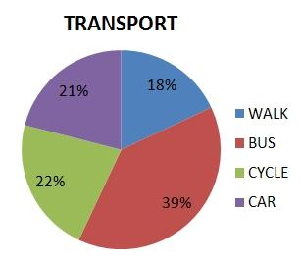
Output

Slide 7
Result
Present findings on fuel consumption before and after optimization efforts
Showcase cost savings achieved through improved fuel efficiency.

